Slide 1

Flight Booking Performance Report
Prepared by
Asmaa Shaban Nagy
Sep 2025

Slide 2

In this report there is a comprehensive overview of flight bookings and passenger behavior based on sales channels and trip types.
Booking Overview: A total of 50,000 bookings were made, with 79,562 passengers. The average number of passengers per booking is 2, indicating frequent group or family travel.
Sales Channel Insight :The majority of bookings were made through the Internet (92%), while only 8% came through Mobile, suggesting a preference for desktop- based planning.
Booking Patterns: Most bookings occur between 7 AM and 10 AM, especially from Monday to Wednesday, indicating peak engagement times for customers.
Trip Type Behavior: - Circle trip bookings lead in advance planning (35%), Followed by One way (34%) and Roundtrip (31%). This suggests that more complex itineraries are planned earlier This analysis supports data-driven decisions for marketing focus, service improvements, and time-based targeting of offers.
Executive Summary

Slide 3
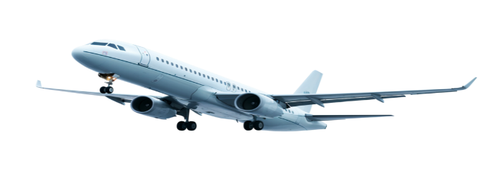

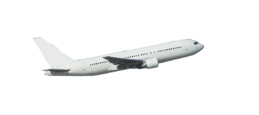
Data Analysis
Most conversations (92%) come through the Internet. Only 8% of conversations come through Mobile.
Uncompleted bookings show a high preference for extras (meals, seats, baggage) at over 80%. Completed bookings show much lower preference, around 16–18%.

Slide 4
Data Analysis
Most bookings occur in the morning and early afternoon, especially on weekends.
Booking activity drops sharply during late-night hours.
Average purchase lead times are close across trip types:
Circle (35%)
One-way (34%)
Round (31%). This shows how far in advance passengers typically book different trip types.

Slide 5
KPIs
Total Bookings: 50,000
Total Passengers: 79,562
Average Passengers per Booking: 2
Completed Bookings Percentage: Only 15% of total bookings are completed
Uncompleted Bookings Percentage: A significant 85% of bookings remain uncompleted.

Slide 6
Recommendations
Most conversations (92%) happen via the Internet, while only 8% come through Mobile so focus resources on enhancing the Internet channel, while exploring ways to boost Mobile engagement.
Concentrate marketing campaigns and promotional offers in the morning and early afternoon—especially on weekends—when booking activity peaks, while using late-night hours for low-cost promotions or system maintenance since booking volume is minimal.
Launch reminder campaigns (emails/SMS) during the typical lead time window to capture undecided travelers before they book elsewhere.

Slide 7
Insights
Booking activity peaks in the morning and early afternoon.
The Internet is the primary channel for customer interactions
Lead times are fairly consistent across all trip types.

Slide 8
The End

